Slide 1

X Education Case Study
Darshan Lama

Slide 2

Background
An education company named X Education sells online courses to industry professionals, many professionals who are interested in the courses land on their website and browse for courses.
We have been provided with a leads dataset from the past with around 9000 data points. This dataset consists of various attributes such as Lead Source, Total Time Spent on Website, Total Visits, Last Activity, etc. which may or may not be useful in ultimately deciding whether a lead will be converted or not. The target variable, in this case, is the column ‘Converted’ which tells whether a past lead was converted or not wherein 1 means it was converted and 0 means it wasn’t converted.
Once these leads are acquired, employees from the sales team start making calls, writing emails, etc. Through this process, some of the leads get converted while most do not.The typical lead conversion rate at X education is around 30%

Slide 3

PROJECT OBJECTIVE
The GOAL of this project is to build a logistic regression model to assign a lead score between 0 and 100 to each of the leads which can be used by the Sales Team in the company to target potential leads with an accuracy of about 80% (Sensitivity) in terms of the lead conversion rate.

Slide 4

Solution
The final model built can help the Sales Team identify 30% more leads with a high probability of conversion, boosting the current overall conversion rate from 38% to 50%.
The model has a sensitivity of 82% (correctly identify true positives)

Slide 5
Model Building Methodology
Data Inspection & Cleaning
Process of detecting and correcting (or removing corrupt or inaccurate data from the given dataset.
EDA & Data Preparation
Exploratory Data Analysis of features to assess its impact on Conversion.
Feature Selection
Feature selection techniques (RFE, VIF & p-value) are used for simplification of models to make them easier to interpret and to make shorter training times.
Model Building
Model Evaluation
Using GLM (General Linear Model) technique, a logistic regression model is built and iterated till it has a high enough Accuracy along with Sensitivity and Specificity to correctly explain the data and predict.
The model is thoroughly evaluated on both the train and test dataset to validate its efficiency using various metrics and methods (Confusion Matrix, Precision/Recall, ROC Curve..)
Transforming the data and splitting it into train and test for model building.

Slide 6
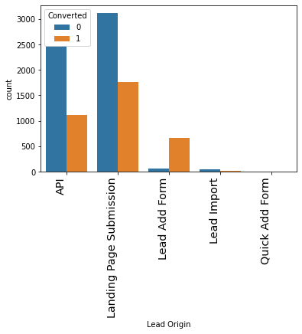
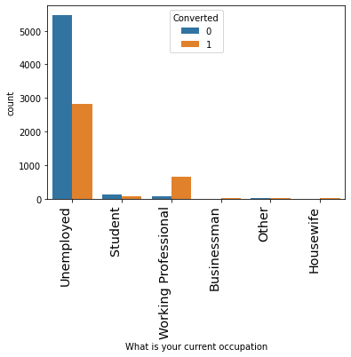
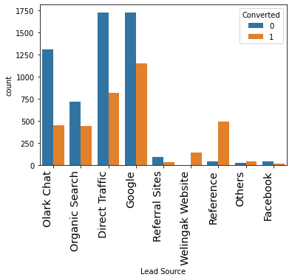
Insights & Inferences
The API and Landing Page Submission are two highest sources of the 'Lead Origin', however the conversion is much higher for Lead Add Form
Most of the leads are Unemployed and the Conversion is also high for it, however it's the Working Professionals who have a better conversion rate.
The best conversion rate can be seen for leads that come through Reference and then the Welingak Website.

Slide 7
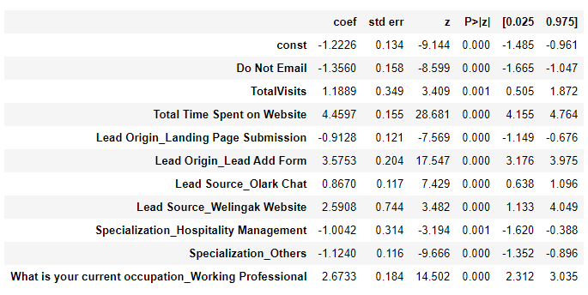
GLM Regression Results (Final Model)
Final set of features(ranked):
Total Time Spent on Website (+4.56)
Lead Origin_Lead Add Form (+3.58)
What is your current occupation_Working Professional (+2.67)
Lead Source_Welingak Website (+2.59)
TotalVisits (+1.19)
Do Not Email (-1.36)
Specialization_Others (-1.12)
Specialization_Hospitality Management (-1)
Lead Origin_Landing Page Submission (-0.91)
Lead Source_Olark Chat (+0.87)
High ‘Lead Score’ is determined by the features listed above wherein higher the ‘coef’ value of the feature, higher it’s impact and the negative value indicates reduction in ‘Lead Score’.

Slide 8



Recommendations
Company can implement the model to get ‘Lead Score’ assigned to all the future system generated leads for the Sales Team to prioritize contacting the leads with higher scores to achieve better conversion rates.
Company should invest more on marketing effort to target working professionals and users of Welingak Website.
Company’s website should be made more engaging for users to spend more time and also work on SEO/SEM to acquire new visitors and increase returning visits.

Slide 9

Thank you
Darshan Lama
hello@darshanlama.com
DarshanLama.com

